Slide 1
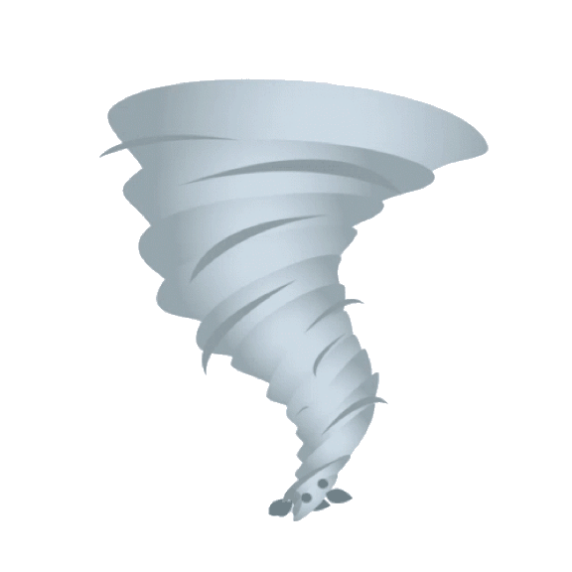
Fury In Motion
Final Presentation

Slide 2
Overview and Goals
General Goals
Team Member Focus
Scientific Goals
Visualize U.S. tornado data in an engaging and interactive format
Present multiple severity metrics (length, width, fatalities, injuries) across spatial and temporal dimensions
Cover a large time range (1950–2023) to identify long-term trends
Allow users to explore tornado behavior across geography, intensity, and context
Build a modular, map-based platform that supports exploratory questions like:
Where do the most damaging tornadoes occur?
How do impact metrics (EF rating, width, fatalities, etc.) vary across the U.S.?
Can we detect environmental patterns linked to tornado severity?
Munshi: Investigated environmental influence on tornado severity using historical weather data (Open-Meteo)
Sam: Explored how tornado frequency and meteorological patterns evolved over time using NOAA station data
Matthew: Analyzed tornado damage in relation to population density using U.S. Census and geoJSON boundary data

Slide 3
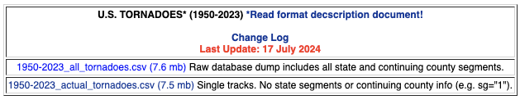
Description of the Data Used
Primary Dataset
US Tornado Dataset (1950–2023)
Source: [NOAA SPC]
Contains: Date, location, magnitude, EF rating, path length, width, injuries, fatalities, start and end locations of recorded tornadoes

Slide 4
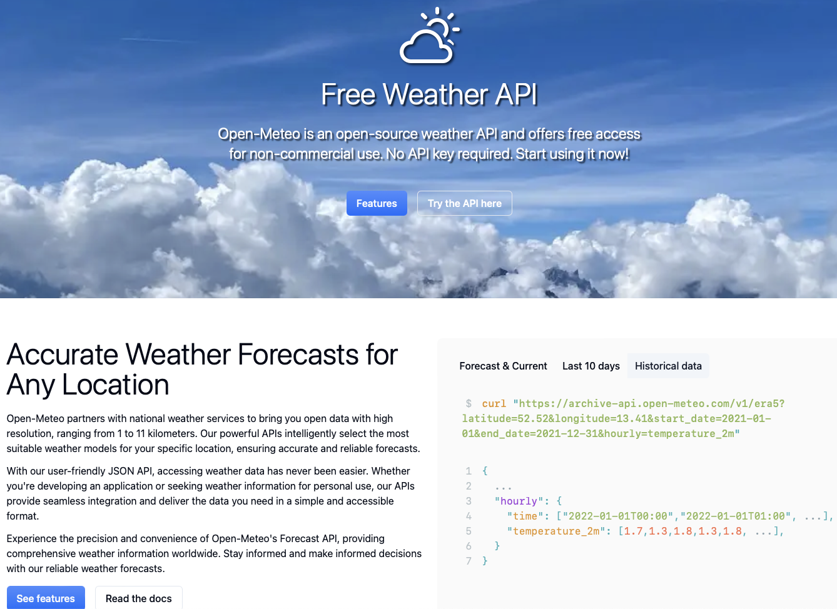
Additional Dataset
Weather Data (Munshi’s Contribution)
Source: [Open-Meteo API]
Used to fetch historical temperature, wind gust, precipitation, and humidity
Enriched 457 top tornado events (length, width, fatalities, injuries)

Slide 5
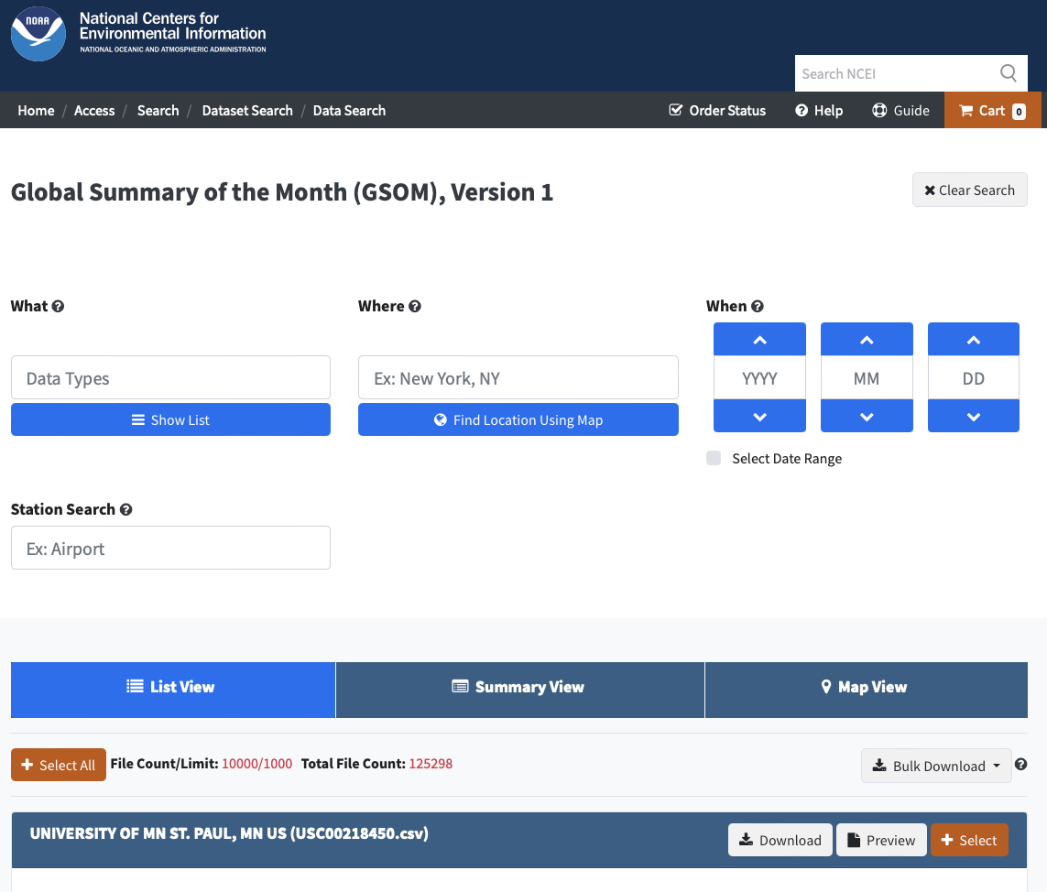
Additional Dataset
Weather Station Data (Sam’s Contribution)
Source: [NOAA Weather Station Records]
Month-to-month climate data across high-risk regions
Used for trend and frequency analysis

Slide 6
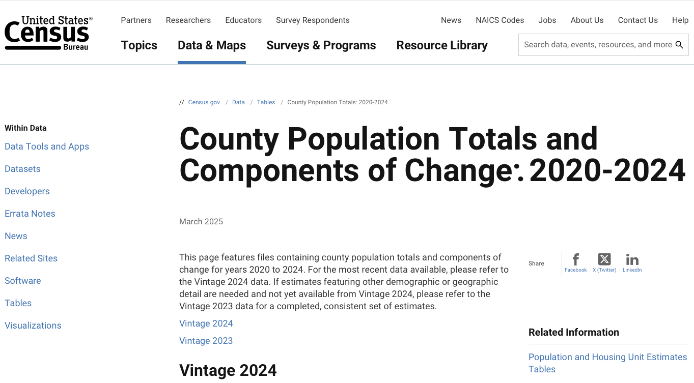
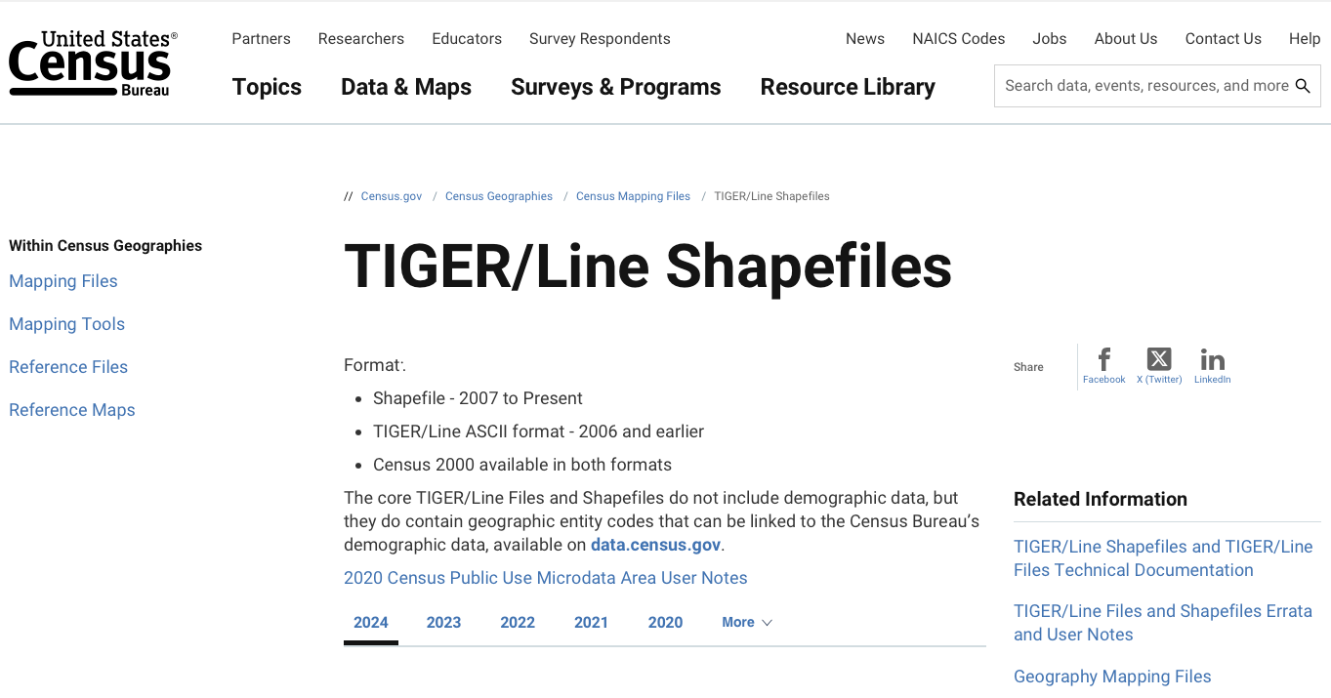
Additional Dataset
Demographics Data (Matthew’s Contribution)
Source: [U.S. Census Bureau]
County population and boundary files (GeoJSON + FIPS)
Enabled tornado impact mapping over populated areas

Slide 7

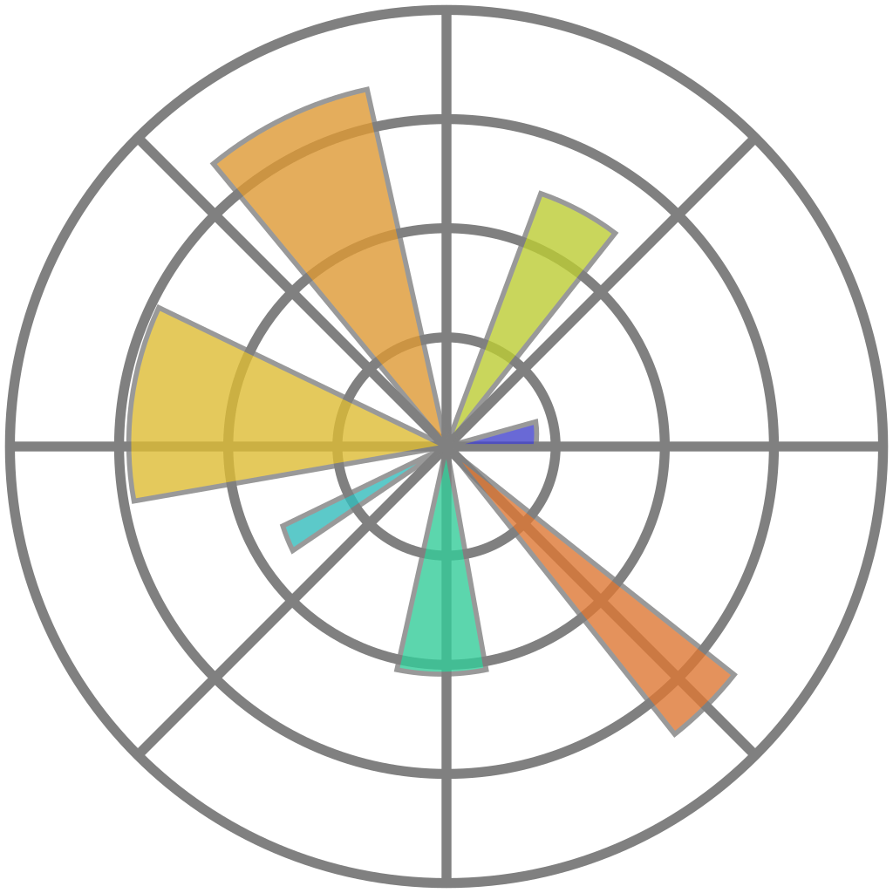





Tools and Libraries Used
Development Environment
Python – Core language used for backend logic, preprocessing, and visualization
Streamlit – Framework for building the interactive frontend dashboard
Geospatial & Mapping
Folium, Matplotlib, PyDeck – Tornado path mapping, EF color-coding, weather popups
GeoPandas – For handling spatial data and U.S. county boundaries
Shapely – Geometric operations on coordinates

Slide 8





Tools and Libraries Used
Visualization Libraries
Plotly – Interactive scatter plots, box plots, radar charts
Matplotlib – Used for static charts
Data Processing & Integration
Pandas – Data wrangling and transformation
NumPy – Numerical operations
TQDM – Progress tracking in prefetching scripts
JSON – For weather caching and API integration

Slide 9
Live Demo: Exploring the Dashboard
Next, I’ll walk you through the core features of our tornado visualization platform. We’ll start by filtering and exploring tornado paths, then compare their severity, and finally explore how environmental conditions align—or don’t—with impact metrics.
Live URL: furyinmotion.streamlit.app

Slide 10
Munshi’s Goal & SOLUTIONS

Slide 11
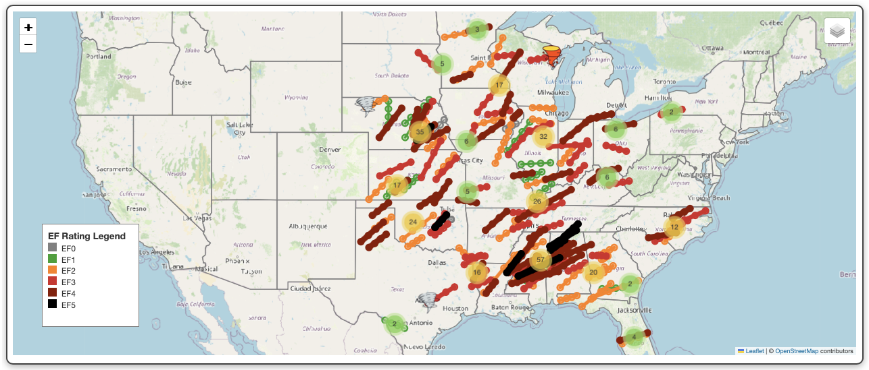
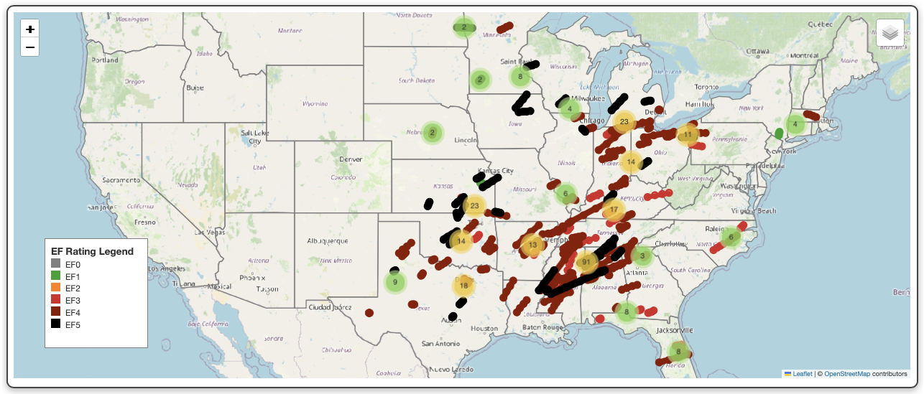
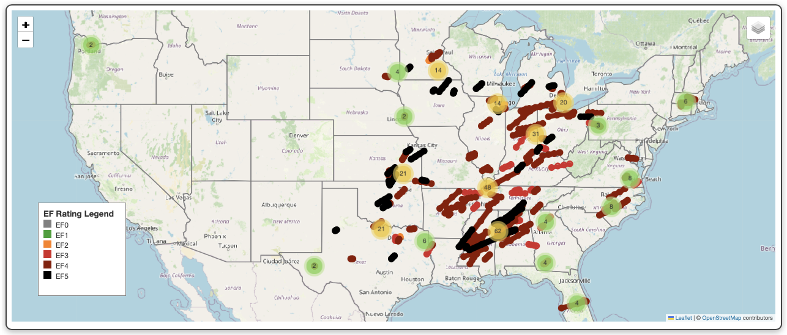
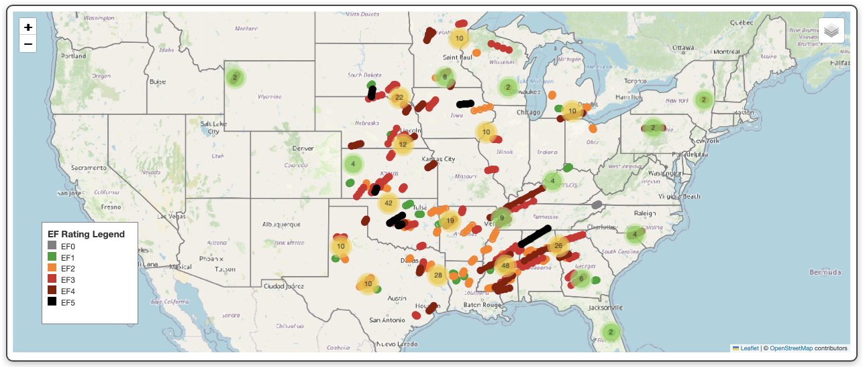
Scientific Question 1: Spatial Patterns & Severity
Length
Fatalities
Key Findings
Long-track tornadoes often span flat terrain across the Midwest
Widest tornadoes (e.g., Oklahoma, Illinois) aren’t always the most fatal or long
Key Findings
Long-track tornadoes often span flat terrain across the Midwest
Widest tornadoes (e.g., Oklahoma, Illinois) aren’t always the most fatal or long
High-fatality tornadoes cluster in the Southeast (especially Alabama, Mississippi, Tennessee)
EF rating does not consistently predict human impact—many EF3 tornadoes caused more fatalities/injuries than EF5
Q. How do tornado characteristics—such as length, width, fatalities, and injuries—distribute spatially across the U.S., and what is the severity along their paths?
Injuries
Width

Slide 12
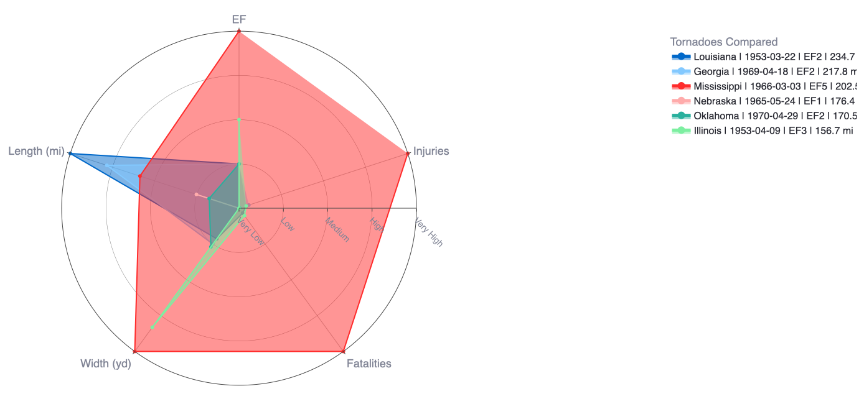
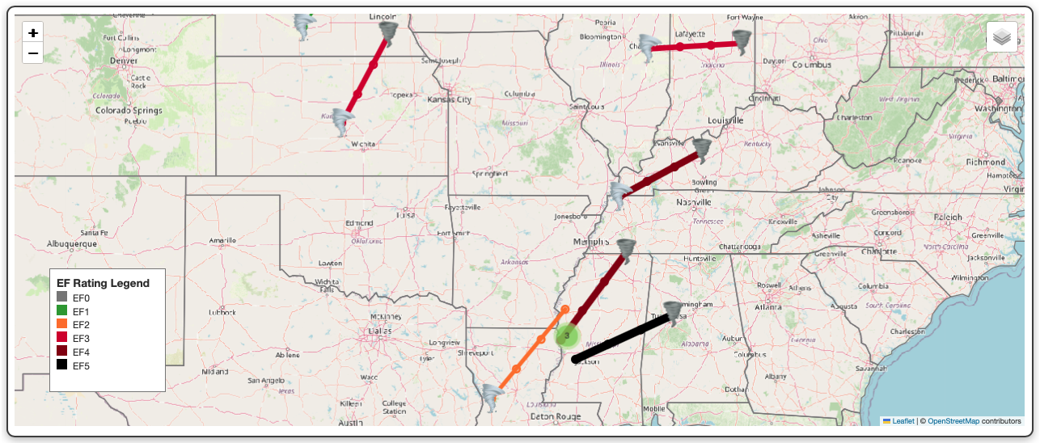
Scientific Question 2: Multi-Metric Tornado Comparison
Q. How do different tornadoes compare across key metrics such as EF Rating, Length, Width, Fatalities, and Injuries?
Key Findings
Radar chart enables normalized comparison across multiple severity metrics
Identified outliers:
Some tornadoes with low EF rating had very high fatalities
Some with long tracks caused minimal injuries
Geographic radar view reveals how tornadoes differ not just in severity, but in spatial footprint
Reinforces that EF rating alone doesn’t capture full impact

Slide 13
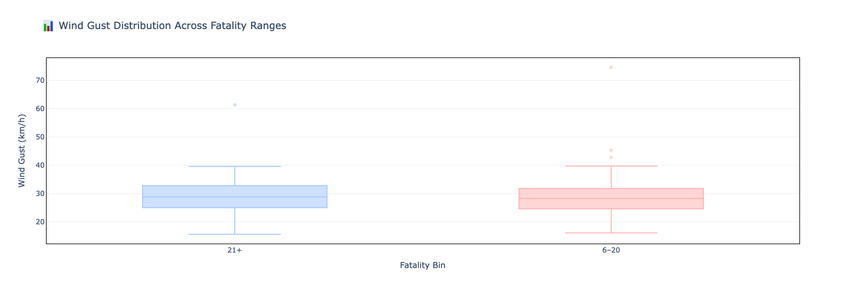
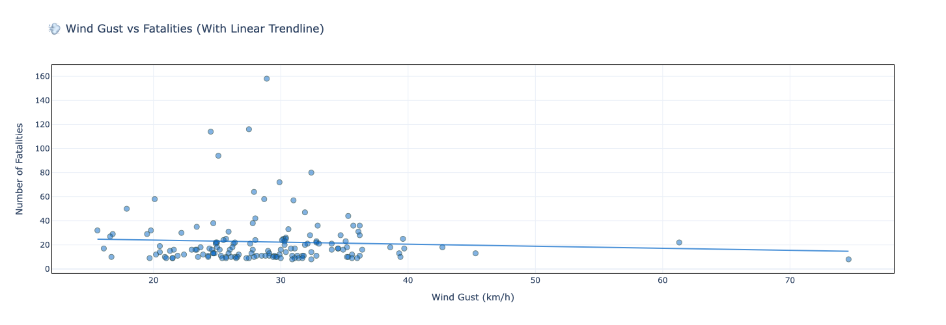
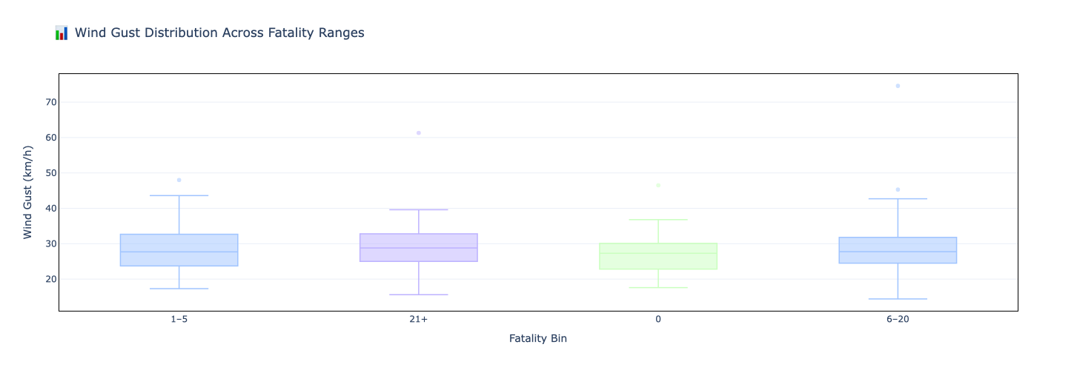
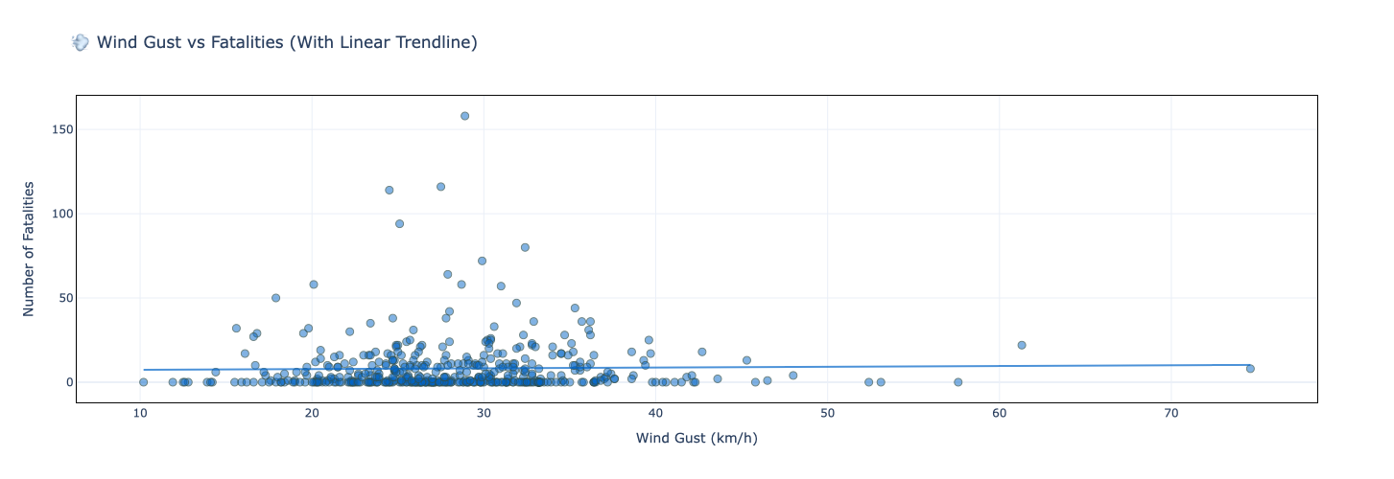
Scientific Question 3: Wind Gusts vs Fatalities
150
Key Findings
No clear correlation between wind gust and fatality count
High-fatality tornadoes occurred during moderate gust conditions as well
Regression trendline is nearly flat or slightly negative in both Top 150 and 457 datasets
Suggests fatalities are shaped more by human context (population, housing) than wind strength
150
Q. Do higher surface wind gusts correlate with more fatalities during tornado events?
Hypothesis: Tornadoes forming on days with intense surface winds would lead to greater damage and casualties (NOAA and Wikipedia)
Visualization Strategy
Scatter Plot: Fatalities vs Wind Gust, with linear regression trendline
Box Plot: Tornadoes grouped by fatality bins (0, 1–5, 6–20, 21+), showing wind gust distribution
457
457

Slide 14
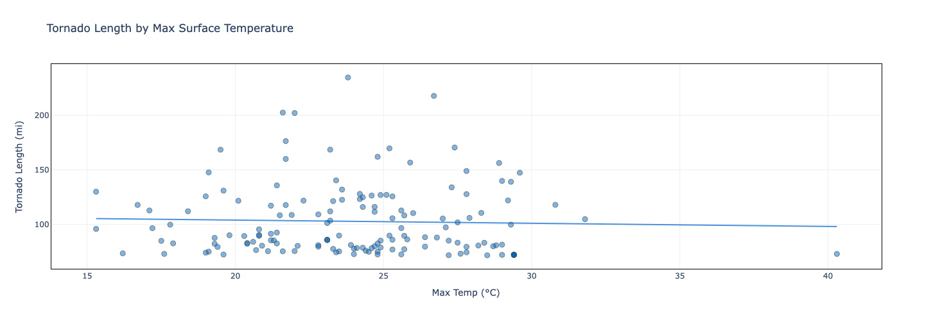
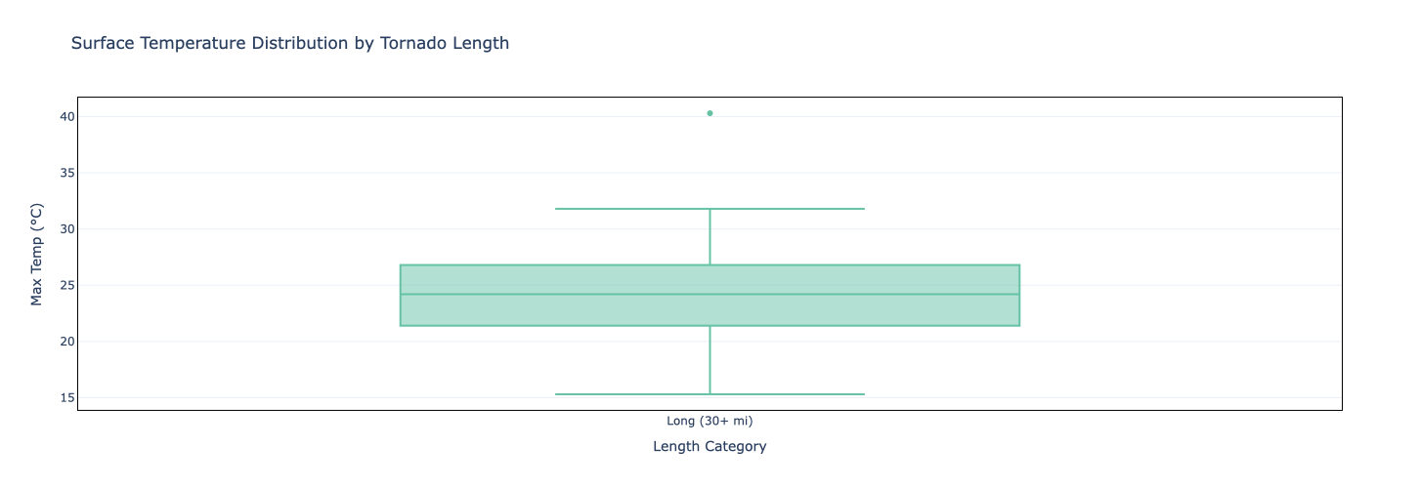
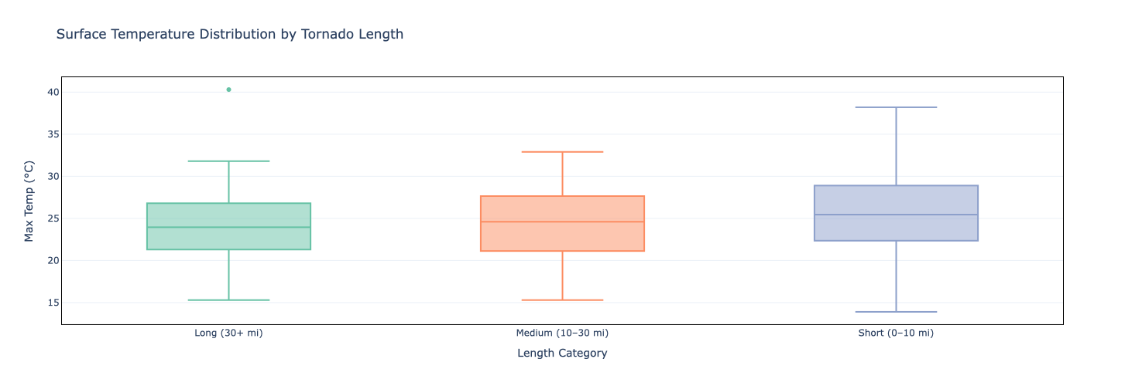
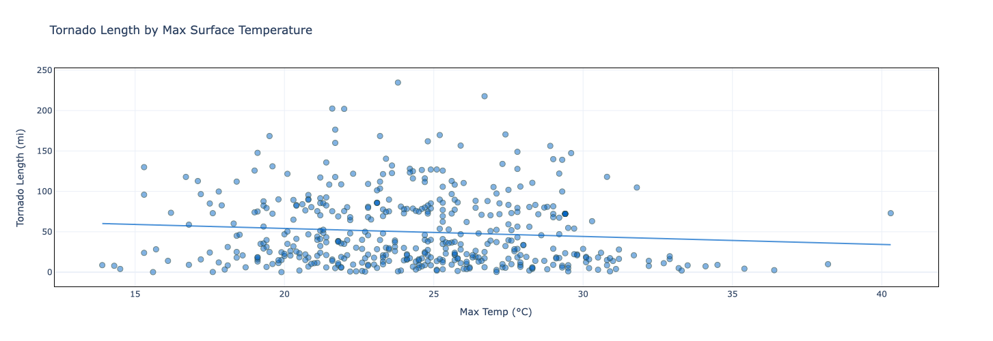
Scientific Question 4: Temperature vs Tornado Length
150
150
Visualization Strategy
Scatter Plot: Tornado length vs max surface temperature (with regression line)
Box Plot: Tornadoes grouped by path length (e.g., 0–10 mi, 10–30 mi, 30+ mi) and compared by median temperature
Q. Do higher surface temperatures correlate with longer tornado paths?
Hypothesis: Warmer surface temperatures, linked to atmospheric instability, would support sustained tornado tracks (NOAA, C2ES, and NIU Newsroom)
Key Findings
No strong positive correlation between temperature and tornado length
Long-path tornadoes often occurred on moderate-temperature days
Short tornadoes occurred across a wide range of high temps
Mild downward trend in full dataset suggests temperature alone doesn’t explain path longevity
Other factors (e.g., wind shear, CAPE, storm structure) likely more influential
457
457

Slide 15
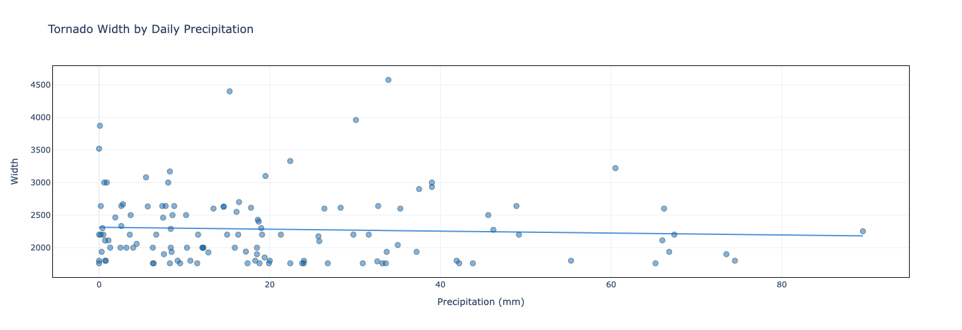
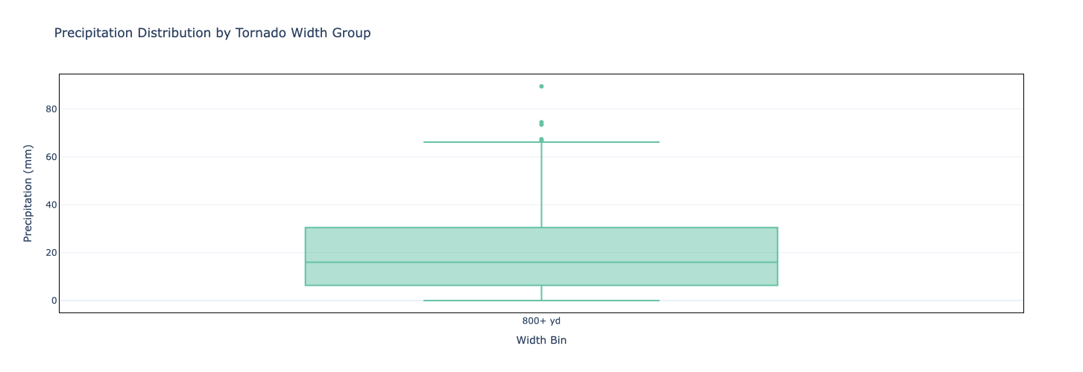
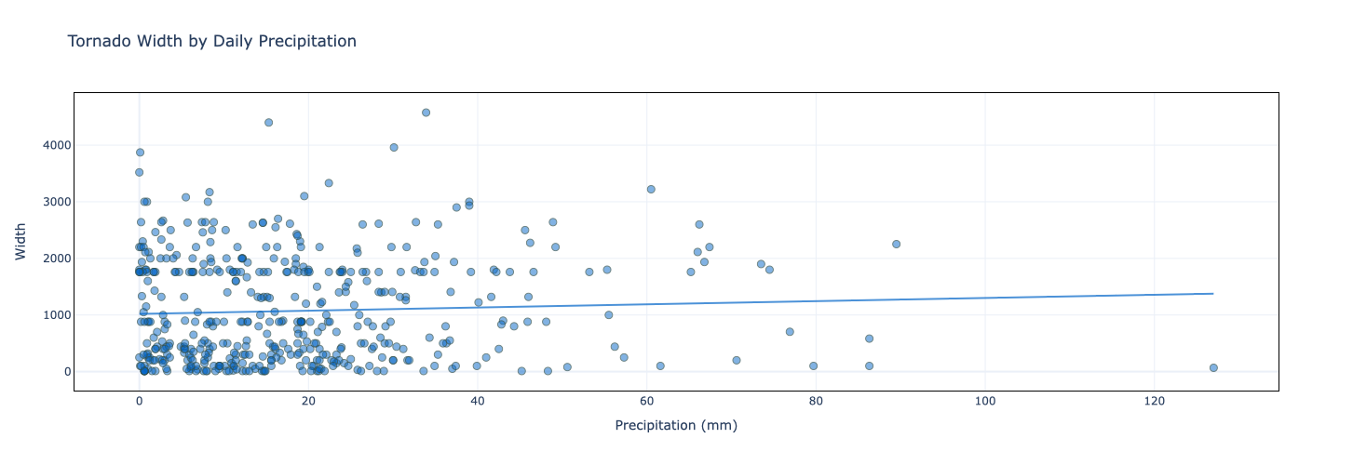
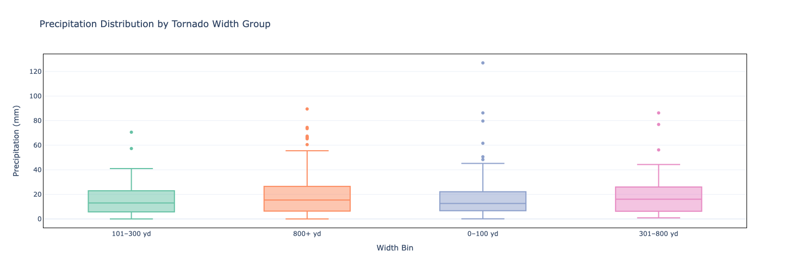
Scientific Question 5: Precipitation vs Tornado Width
150
150
Key Findings
No consistent relationship between precipitation and tornado width
Scatter plots show only a mild positive trend in full dataset
Box plots reveal wide variability and overlapping medians across all width bins
Outliers exist (e.g., some wide tornadoes occurred on very rainy days), but not enough for a general pattern
Suggests tornado width is more influenced by storm dynamics than rainfall amount
Visualization Strategy
Scatter Plot: Tornado width vs precipitation, with trendline
Box Plot: Tornadoes categorized by width (e.g., 0–100 yd, 101–300 yd, 301–800 yd, 800+ yd), showing rainfall variation
Q. Do tornadoes that form on days with heavier rainfall tend to have wider paths?
Hypothesis: Precipitation may signal convective intensity and thus wider tornado footprints (Joshua et al. and weather.gov)
457
457

Slide 16
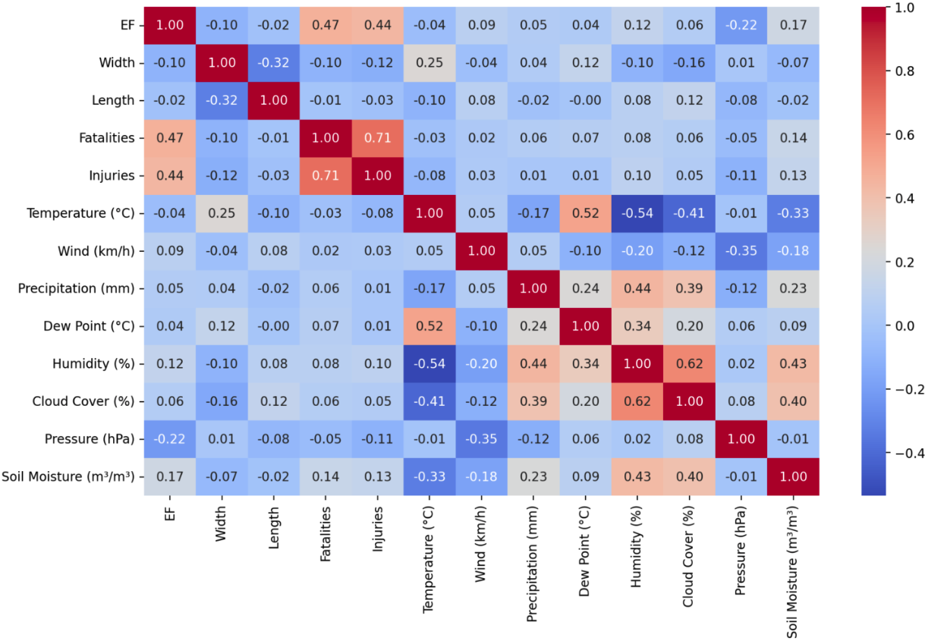
Correlation Matrix Summary
What It Shows
Pearson correlation values between tornado severity metrics (EF rating, length, width, fatalities, injuries) and weather conditions (temp, wind gust, precipitation, humidity, pressure, soil moisture)
Key Findings
EF Rating ↔ Fatalities: Strong positive correlation (0.47)
EF Rating ↔ Injuries: Also strong (0.44)
Fatalities ↔ Injuries: Extremely high (0.71) — expected
Precipitation / Temp / Wind: Weak or no correlation with width, length, or casualties
Pressure ↔ EF: Mild negative correlation (–0.22) — not deeply explored here
Soil Moisture: Weak positive correlation with EF and injuries (future potential)
Summary Interpretation
Validates that our top-N visual insights reflect broader patterns
Confirms that tornado severity is multifactorial, not easily predicted by individual weather variables
Supports need for multi-metric preparedness frameworks, not EF rating alone

Slide 17
Munshi’s solution slide(s)
Length
Fatalities
Injuries
Width

Slide 18
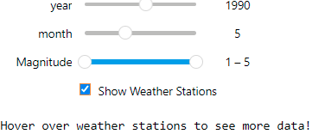
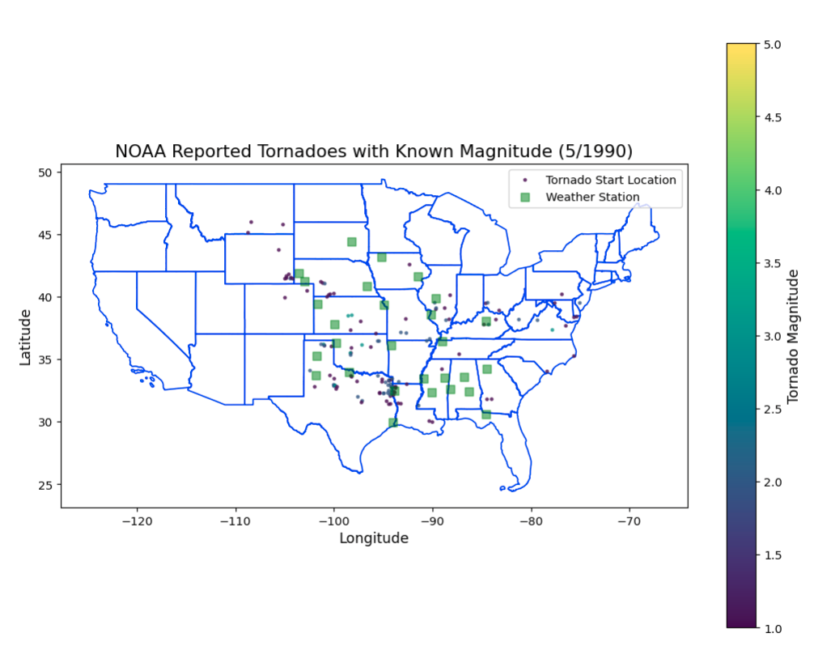
Sam’s solution slide(s)
Main Feature - interactive map showing tornado distribution for a particular month and year. Sliders allow for selection of both, and additional filtering of magnitude is available. Weather stations include data for each month like temperature trends and precipitation, as well as elevation. They can be toggled on or off to reduce clutter.
This visualization is designed to explore questions like:
“What months have the most tornadoes?”
“How do weather conditions influence tornadoes?”
“How does tornado distribution change over time?”
And generally, just allow the viewer to intuitively view the information in the tornado dataset with a bit more fine-tuning.

Slide 19
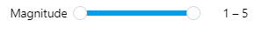
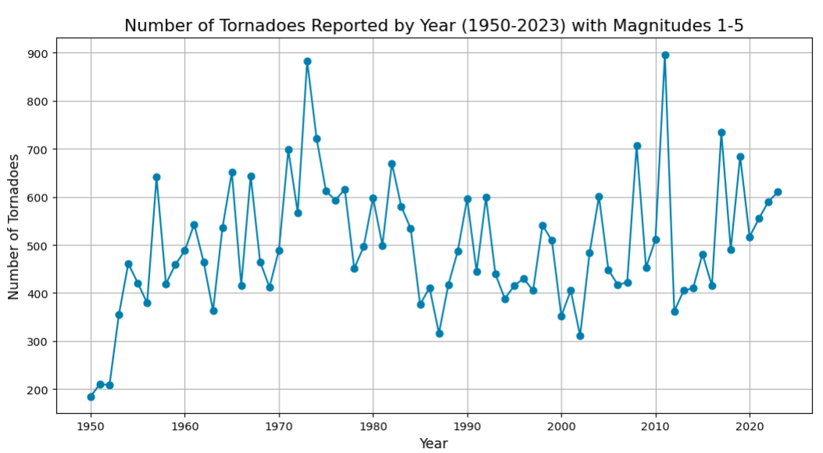
Sam’s solution slide(s)
Add-on: A standard line plot of tornadoes over time. The interactive widget simply allows a range of magnitudes to be selected (or just one magnitude, ie 3-3).
Helps answer questions like:
“How has the frequency of tornadoes varied over time?”
A more traditional representation of the core dataset we’re investigating. You can also make out interesting patterns here, like how drastically the number of tornadoes can vary year-to-year and whether those trends apply for all magnitudes.

Slide 20
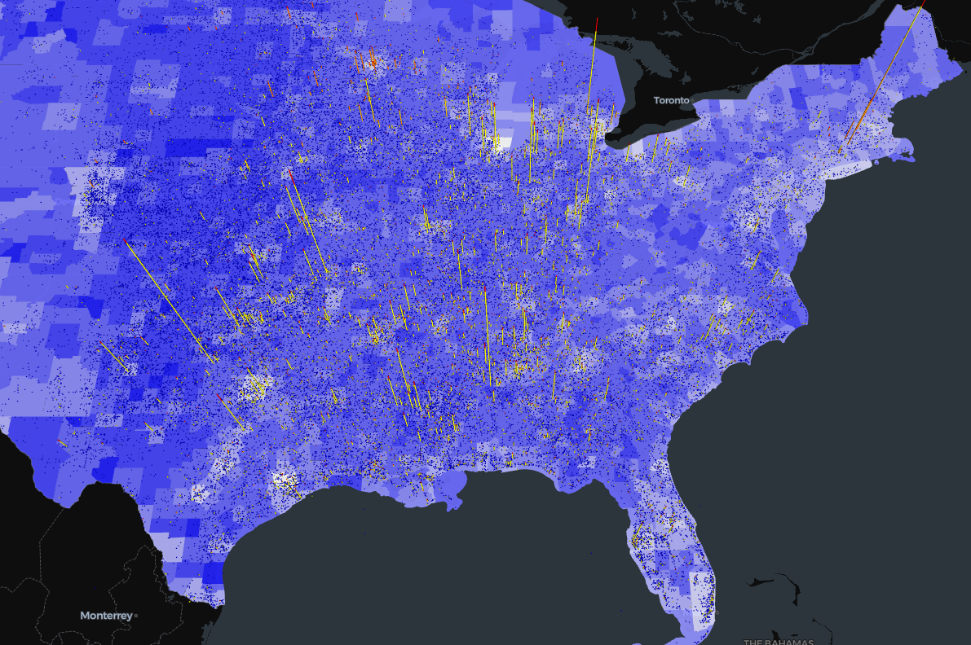
Matthew’s solution slide(s)
Main Feature - An interactive choropleth map featuring geo-referenced stacked charts indicating the number of fatalities and injuries caused by tornados.
By geo-referencing the injuries and fatalities with the starting location of the tornado and overlaying the information, this visualization is designed to answer questions such as:
“Where did the most deadly tornadoes occur?”
“Which areas are most prone to tornadoes?” and
“How are the injuries and fatalities caused by a tornado related to the population size of the affected area?”

Slide 21
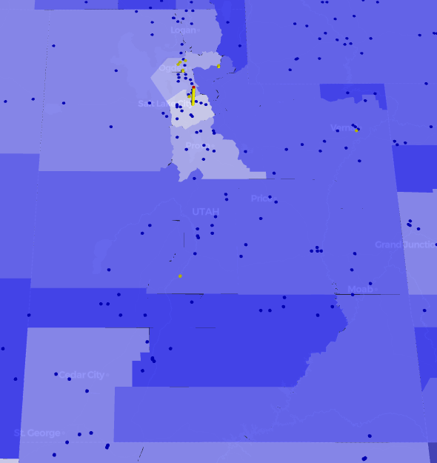
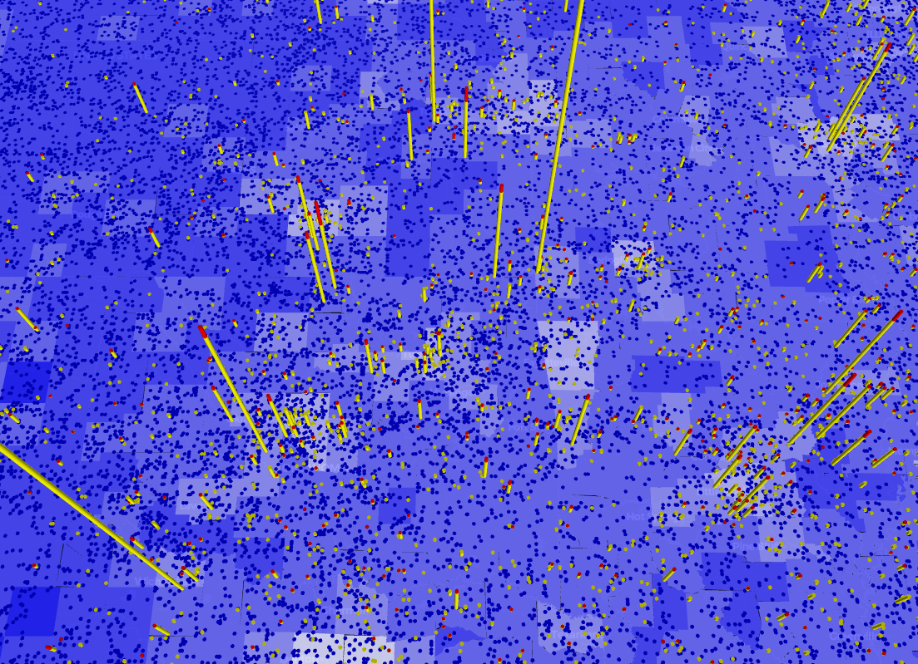
Matthew’s solution slide(s)
Utah
Oklahoma

Slide 22
Challenges & Technical Hurdles
Technical Challenges:
API Rate Limits: Open-Meteo had usage restrictions, requiring a prefetching and caching system to avoid repeated requests.
Data Integration Complexity: Merging NOAA tornado data with weather APIs by time and location needed custom handling for consistency.
Map Overcrowding: Visualizing hundreds of tornado paths with EF segments led to clutter—solved through Top-N filtering and toggles.
Weather station datasets contained excessive and inconsistent variables, often missing values or covering different time periods—required careful selection and filtering
No stacked bar support in PyDeck to visualize fatalities and injuries simultaneously
Had to simplify county boundary geometry to reduce shapefile size and prevent lag
Scientific Challenges:
Weak Correlations: Many initial hypotheses (e.g., wind gusts → fatalities) didn’t hold, requiring re-evaluation of scientific framing.
Balancing Interactivity vs Clarity: Too many toggles and layers made the interface overwhelming—had to prioritize usability.
Validating Visual Insights: Needed to back up pattern observations with statistical validation (e.g., correlation matrix)

Slide 23
Changes to the initial plan
We hadn’t really defined our particular sections by the initial proposal, and as we worked on the project we gained a better understanding of what we each wanted to focus on.
Sam’s section had to add more weather station data than he thought, since covering a larger area was necessary. He also added an additional plot for a different way to visualize.
Matthew had originally intended to explore how financial damages related to the number of fatalities/injuries caused by a hurricane, but struggled to find an appropriate insurance dataset. He moved on to exploring the relationship between population and tornado damages before realizing that there may have been some relevant data stored in a separate NOAA dataset regarding financial damages.
The project evolved from a simple visual comparison to a full data-driven exploration platform with scientific depth.

Slide 24


